Slide 1
Augmented Reality
Presenter – Stephanie Bass
www.tinyurl.com/VSTEaugmentedreality

Slide 2
What is Augmented Reality?
Common Craft Video Explaining Augmented Reality.
http://www.youtube.com/watch?v=D-A1l4Jn6EY

Slide 3
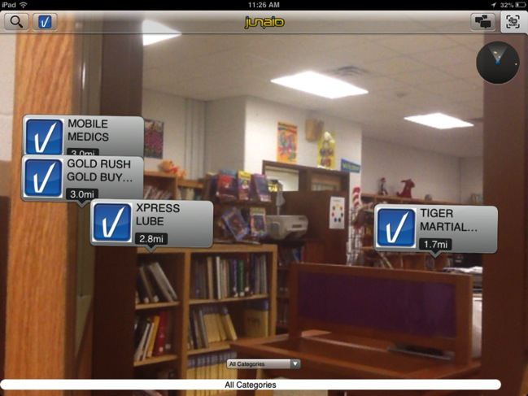
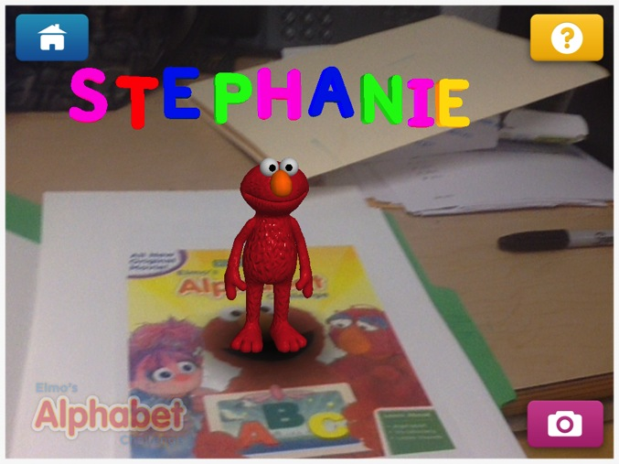

Location Based
This uses GPS to show content.
It depends where you are, you and I will not see the same information.
Marker Based
Printed Markers show content.
We will see the same information.
They all look different, some use background, some don’t.

Slide 4
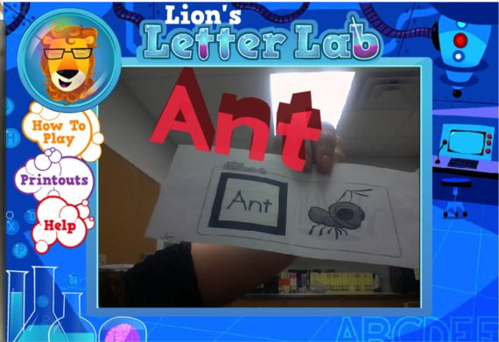
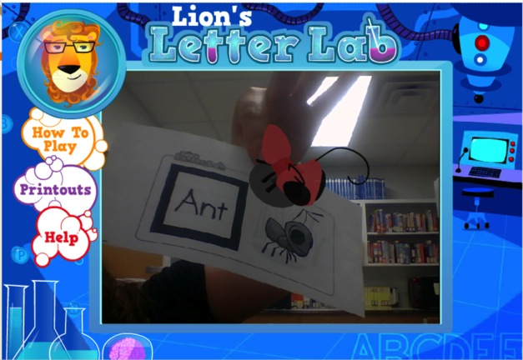
Lion’s Letter Lab
Website
Also Includes:
Cosmic Counting
Adventures in Food
Lion’s Music Den

Slide 5
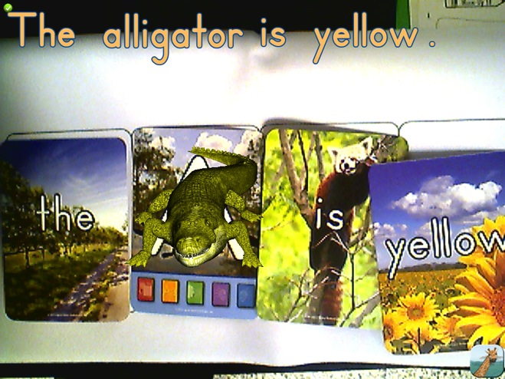
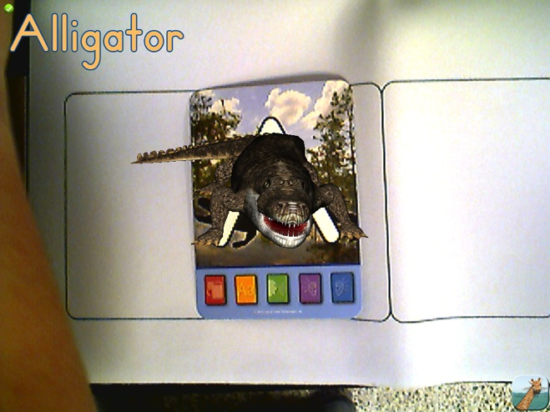
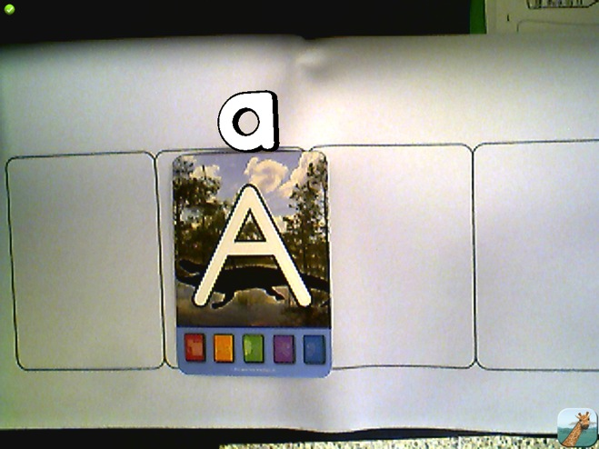
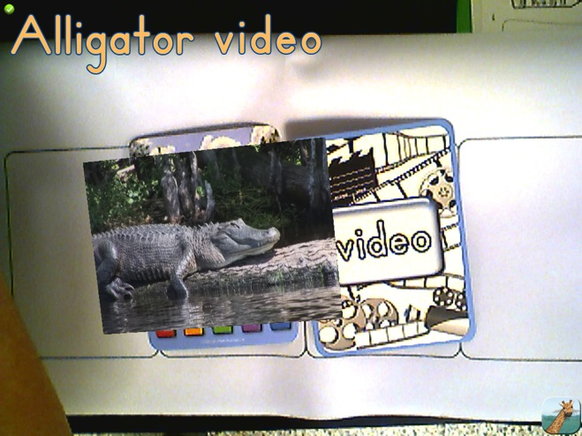
Letters Alive
Program

Slide 6




Android apps
Google Sky Map – Look at the stars, planets, etc.
Shake Fighter – Rock, Paper, Scissors
Kafkara – Put people’s heads on insects bodies.
Movue – Scan around to see reviews. Yelp

Slide 7

AR Media
Download the information for the image first.
Scan the marker. (Same marker for all pictures)
Free Install for Computer
OR
App
AR Media Player

Slide 8
Question Break!

Slide 9
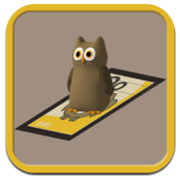
Ideas
Letter Practice
Take a picture of it and write a the word, sentence or paragraph.
Place the markers around the room, have students find the one that starts their name and move to that marker.
Alphabet Cards
Touch the animal, listen to the letter and type of animal.
AR Flashcards
Marker Based
Paid $0.99

Slide 10

The students practice different addition and subtraction facts. It includes “find the missing number.”
Place the cards around the room and release the children! For a whole class or large group, print multiple copies to cut down on congestion.
Lunch Rush
Marker Based
Free
Basic Math

Slide 11


This app runs on its own. The book would be great to pair with it because some of the animations are not clear.
Parrot Carrot
Based on a children’s book.
Rhyming Words
Paid $1.99

Slide 12


There are certain pages and entries that are augmented. The list is in the table of contents.
GWR2013
Marker Based
Free

Slide 13

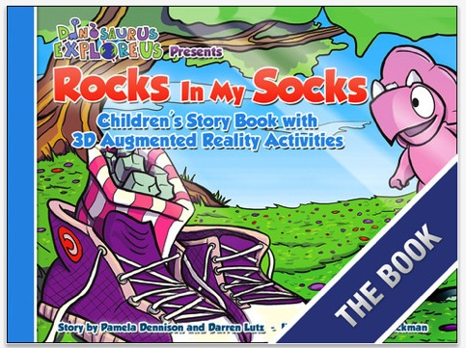
You can get 1 free PDF to go with the app.
The book is available online. There are several activities included after the story, some are augmented, some are not.
AR Flashcards
Marker Based
Paid $0.99

Slide 14

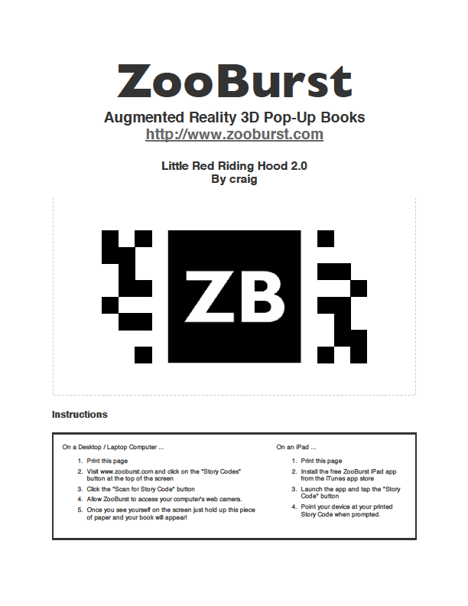
A premium account is required to create story codes (not the story).
Ideas
Send home the story code and have parents view their child’s book.
Post story codes at PTA for people to explore.
AR Flashcards
Marker Based
Free

Slide 15

This one is just FUN.
Brain Break!!!
Find the shirts and other Zappar-linked items online.
Some are sold at Wal-Mart and Target.
Zappar
Marker Based
Free

Slide 16
Question Break!

Slide 17

The shirts are cutsie kids shirts, but when you scan them it gives you factual information about the animal. You do not have to hold the camera on the shirt for it to continue.
Have students answer questions about the animals based on the information. Special reward- Student gets to wear the shirt!
This app pairs with children’s T-shirts.
We found the T-shirts at Wal-Mart.
Extreme Concepts
Marker Based
Free

Slide 18

The students can:
-Answer questions.
-Take a picture.
-Write an informational paragraph.
-Write a creative story.
There are also Letter and Number cards!
Cypher Kids Club
Marker Based
Free

Slide 19

Groupon
SpotCrime
Weather
Wikipedia World
Magazines
Puzzles
Games
Interactive Maps
Layar
Marker Based
Location Based

Slide 20

Create tags and hang them in your location.
Be careful, you can’t control what other people have tagged.
Scan to find tags near you.
Comment on tags near you.
Sekai
Location Based
Free

Slide 21
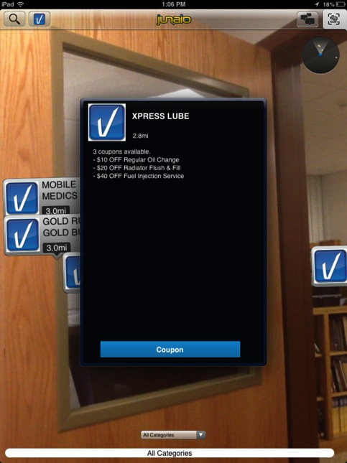
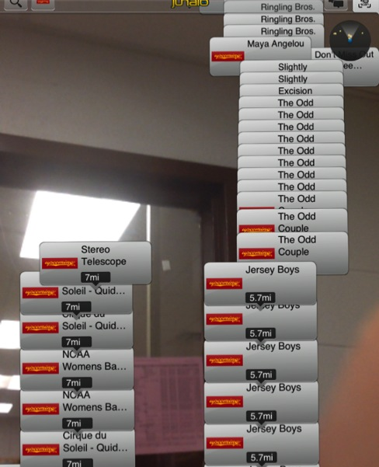

Junaio
Location Based
Free

Slide 22

Create your own!
Fill out an application online for Aurasma Studio.
Upload your own pictures/video or use preloaded ones.
You can use anything as the marker (Aura).
Upload videos for learning.
Do a picture walk.
Sequence a story.
Play!
Aurasma
Marker Based
Free

Slide 23
Question Break!
?Sharing?

