Slide 1


http://metaatem.net/words
Eight (or more) of our most common recommendations
(using tools and strategies already found
in every educator's environment)
Chris Bugaj and Sally Norton-Darr
Loudoun County Public Schools
Notes:
First strategy flickr

Slide 2
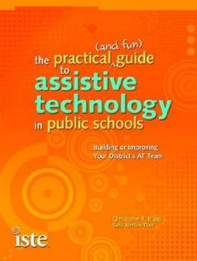

Contact Us!
Sally Norton-Darr
  snortondarr@yahoo.com
Christopher Bugaj
  attipscast@gmail.com
  @attipscast via Twitter
  tinyurl.com/attipscast
  attipscast.com
For More Info:
http://iste.org/chewat
Facebook Site:
http://bit.ly/atbookfb
Notes:
Change color of texts

Slide 3
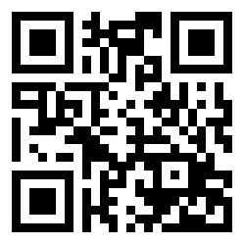
Follow along with the
Google Presentation:
http://bit.ly/great8vstewebinar2013

Slide 4
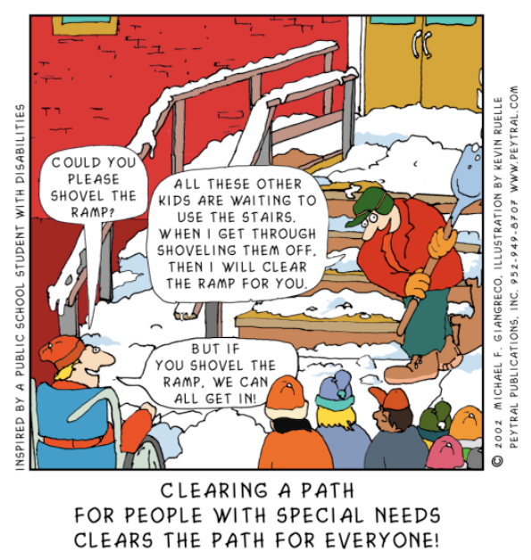
Definition & History
Notes:
History of UD
Brief history of UD
Built into design
Ask for examples

Slide 5

Universal Design for Learning (UDL) is the practice of embedding flexible strategies into the curriculum during the PLANNING PROCESS so that ALL students can access a variety of learning solutions.

Slide 6

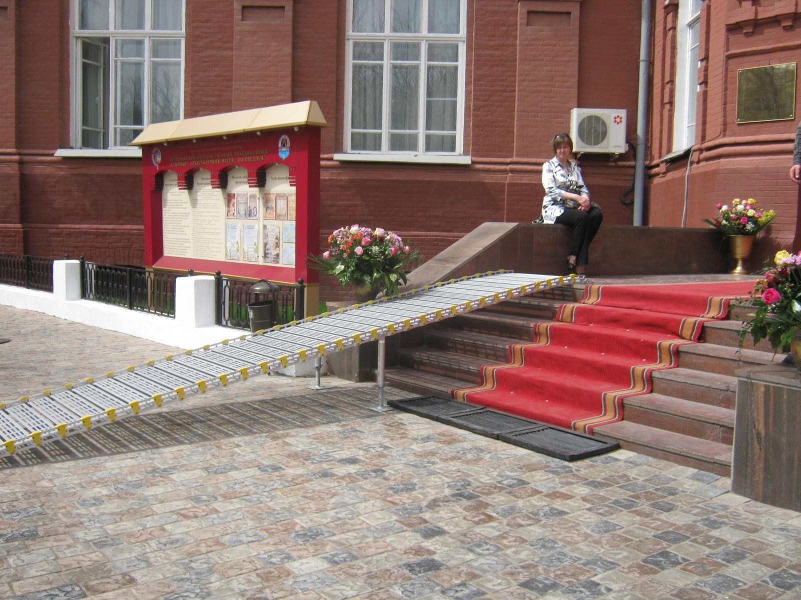
Universal Design for Learning (UDL) is a framework for removing barriers by
ANTICIPATING the needs of all students.

Slide 7
How Do We Do It?
Multiple Means of Engagement | Multiple Means of Representation | Multiple Means of Action & Expression
How do we engage students? | How do we present information to students? | How do students share what they know?
Short Video Explaining UDL:
http://bit.ly/udlexplainedvid
CAST UDL GUIDELINES:
http://bit.ly/castudlguidelines

Slide 8
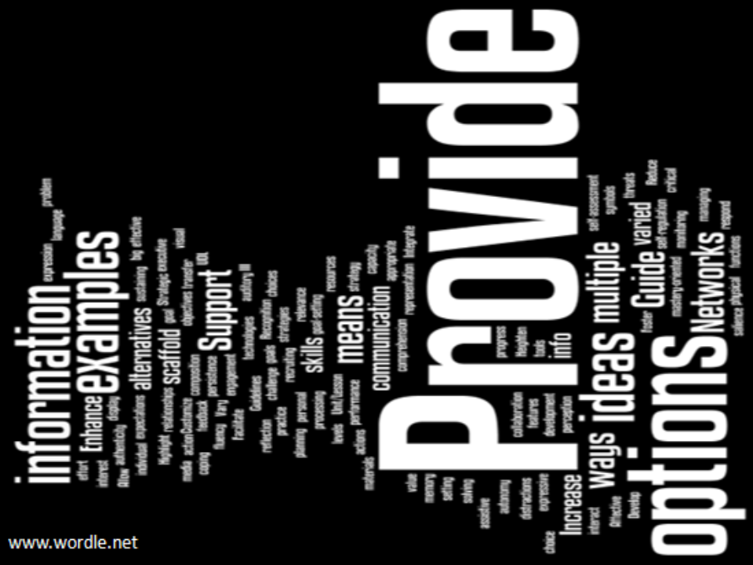

Slide 9
UDL can help you!
Meet Adequate Yearly Progress (for all students!)
A rubric for purchasing/implementation decisions
  What technology to buy
    Online subscriptions
    Hardware
    Software
  Textbooks with multiple modalities
  Construction plans & modifications
  to existing structures
Framework for professional development
Notes:
UDL meets any educational initiative
Rewrite curriculum see Montgomery County, MD
Buy accessible instructional materials

Slide 10

Once You Know About UDL,
What Comes Next?
Tools & Resources!
Blog: http://bit.ly/udlnextblog
Audio: http://bit.ly/udlnextaudio
MCPS UDL Tools Quick Guide http://bit.ly/mcpsudltoolguide

Slide 11
AT Continuum & Least Restrictive Environment
The possibilities are endless, so which tools do we look to
implement first?
Go from least restrictive
to most restrictive solutions.

Slide 12
Use whatchya got!
The Philosophy:
Use the technology that is already in place first to meet the needs of students.
This Philosophy means…
  Consider low tech strategies first, then move to high tech as needed
  Implement technology that is least restrictive
  Better rate of adoption and less chance of abandonment
  Use a Universal Design for Learning approach
  All students (not just those in special education) will benefit
  You’ll save money!!!!
  You’ll save time!!!!
  Students implement strategies faster

Slide 13

Text to Speech (bi-modal)
Listening While Reading a Story = 2 Modes of Input
Free Web Tools
  Vozme.com
  Natural Reader
  WordTalk.org Add-in
  Voice Over on iOS
Evidence
  List of Research Articles Supporting the Use of TTS:
  http://bit.ly/ttsresearchfromcast
Assessment to Determine Effective Supports:
PAR from DJ (Free) http://bit.ly/pardj

Slide 14
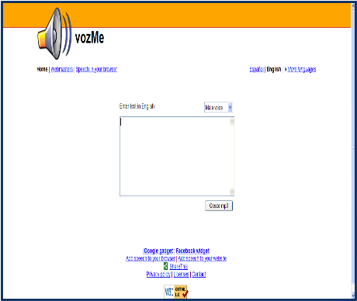
Vozme.com - Text-to-Speech
Audio Description
http://bit.ly/audiovozme

Slide 15

The Great Eight+
High-Contrast in Windows / iOS
PhotoAlbum Feature of PowerPoint (PowerTalk Demo too!)
Visual Schedules (Linear and Amorphous)
Keyboarding Sites
Social “Situation” Stories
Sound Record Feature of MS Word*
Graphic Organizers (paper, software, Internet)
Pacing Boards (communication strategy)
Listening Stations (Audio in the Classroom)
Graphic Organizers (paper, software, Internet)
Pacing Boards (communication strategy)
Listening Stations (Audio in the Classroom)
Notes:
We call out “What do you want to learn about” We demonstrate the top 1. We count up the numbers to determine the top one. We do this three separate time. State that these are sometimes in flux (sometimes there are 9 or 10).
20 - 30 minutes – 10 minutes a piece.

Slide 16
High Contrast in Windows
Tutorial – http://bit.ly/highcontrast4u
Podcast – http://bit.ly/53audiohighcontrast
Blog - http://bit.ly/episode53highcontrast
Video - http://bit.ly/shiftaltprntscrn

Slide 17
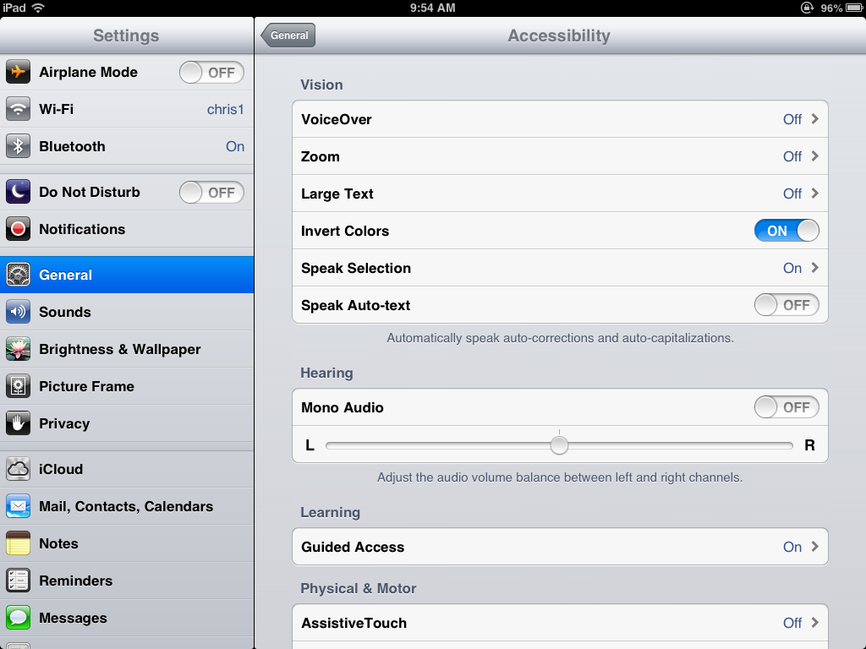
Invert Colors
Text Tutorial - http://bit.ly/iosaccessibility
Video Tutorial - http://bit.ly/highcontrastvideotutorial
Podcast -
http://bit.ly/itsaliveaudio

Slide 18

PhotoAlbum Feature of PowerPoint
Tutorial - http://bit.ly/powerpointphotoalbum
Podcast - http://bit.ly/ep39audiopowerpointphotoalbum
Blog - http://bit.ly/ep39blogpowerpointphotoalbum
Video - http://bit.ly/videopowerpointphotoalbum
Implementation Ideas - http://bit.ly/attb102
Notes:
We call out “What do you want to learn about” We demonstrate the top 1. We count up the numbers to determine the top one. We do this three separate time. State that these are sometimes in flux (sometimes there are 9 or 10).
20 - 30 minutes – 10 minutes a piece.

Slide 19
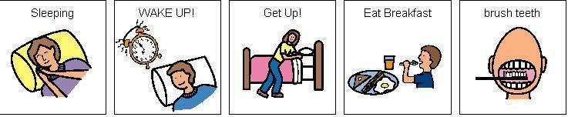
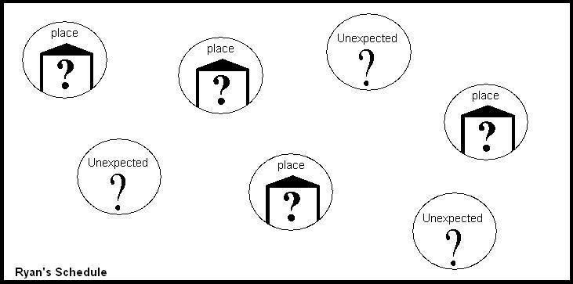
Visual Schedules
Linear -
  Blog: http://bit.ly/ep17linearvisualschedules
  Podcast: http://bit.ly/ep17linearvisualschedulesaudio
WHAT IS A TOOLS CHECKLIST?
Amorphous –
  Blog: http://bit.ly/ep18amorphousvisualschedules
  Podcast: http://bit.ly/ep18amorphousvisualschedulesaudio
Notes:
We call out “What do you want to learn about” We demonstrate the top 1. We count up the numbers to determine the top one. We do this three separate time. State that these are sometimes in flux (sometimes there are 9 or 10).
20 - 30 minutes – 10 minutes a piece.

Slide 20
Keyboarding/Typing Tutorials
  Goodtyping.com
  Keybr.com
  Buttonbeats.com
    The user makes music by pressing keys
Podcast describing these:
http://bit.ly/typingaudio1
Podcast describing these:
http://bit.ly/typingaudio2
  Play.typeracer.com
  Typingweb.com
  www.bbc.co.uk/schools/typing
HIAT Comparison Chart: http://bit.ly/HIATkeyboarding

Slide 21

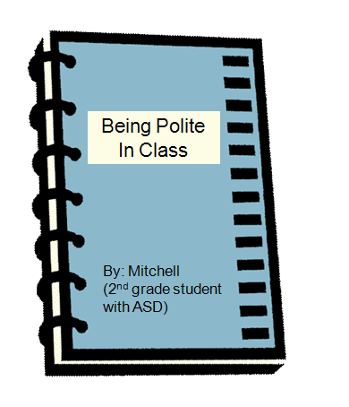
Social Situation Stories
Introduction and examples -
www.bit.ly/socialstoryindex
More examples - www.region2library.org/SocialStories.htm
More examples - http://bit.ly/csefelstrategies
More examples - http://bit.ly/watsonstories
"I Like Sleeping" example - http://bit.ly/maggiesleeps

Slide 22

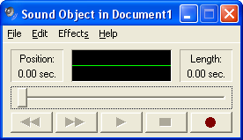
Sound Record in MS Word
Tutorial - http://bit.ly/recaudword
Tutorial - http://tinyurl.com/quickrecord
Blog - http://bit.ly/ep2blogrecinword
Podcast - http://bit.ly/ep2audiorecinword

Slide 23
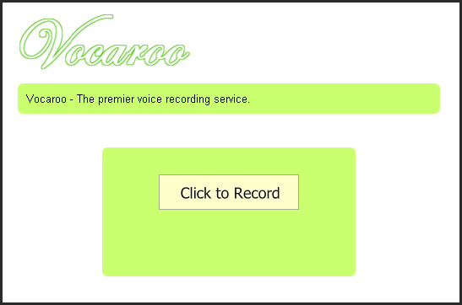
Vocaroo.com - Voice Recorder
Audio Describing Uses
http://bit.ly/vocideas

Slide 24
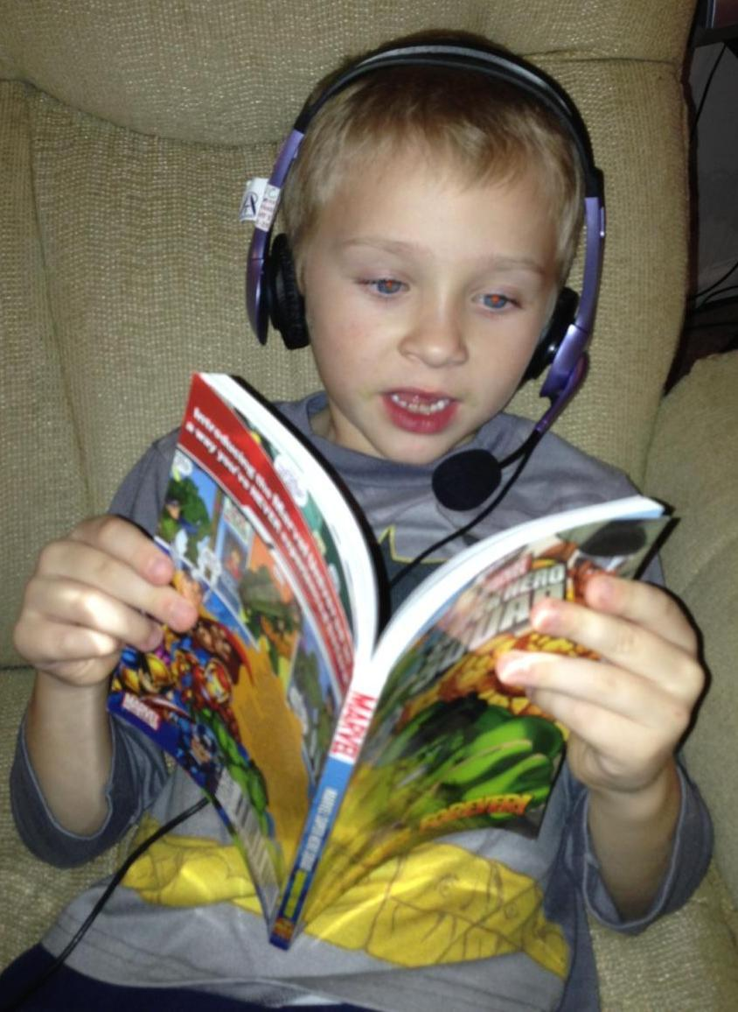

More Ways to Create Audio
Tools
  Audacity (Free Download)
  Recordmp3.org
  Audioboo.com
  Chirbit.com
  Sound Recorder
  in Windows
  Voice Memo Apps
  Flying Books App
Evidence
http://bit.ly/createtalkingbooksresearch

Slide 25
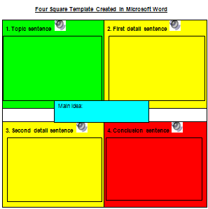
Graphic Organizers
Templates - eduplace.com/graphicorganizer
More Templates - http://bit.ly/holtgos
Blog - http://bit.ly/ep37goi1blog
Podcast: http://bit.ly/ep37goi1audio
Web 2.0 Tools:
http://bubbl.us
http://mindmeister.com
http://mindomo.com
http://mind42.com
http://gliffy.com
http://cacoo.com
http://spiderscribe.net
LCPS AT Diigo Resources: http://bit.ly/lcpsatdiigogos
Notes:
Remember to talk about WHY to use these and how this can be used as a teacher prompt as well.
Have people shout out answers to fill a graphic organizer on screen.

Slide 26
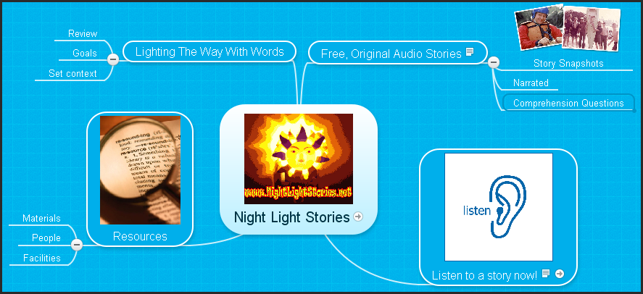
MindMeister.com

Slide 27

Pacing Boards
Video - http://bit.ly/keepingpace
Blog - http://bit.ly/ep5pacingboardblog
Podcast - http://bit.ly/ep5audiopacingboards

Slide 28
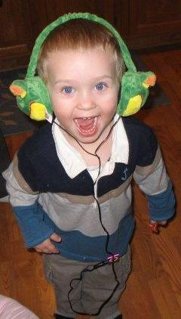

Listening Stations
Tutorial - http://slidesha.re/powerofpodcastingpreso
Research - http://bit.ly/audiostoriesimprovereading
Blog - http://bit.ly/listeningstationblog
Podcast - http://bit.ly/listeningstationaudio

Slide 29


FREE AUDIO STORIES

Slide 30
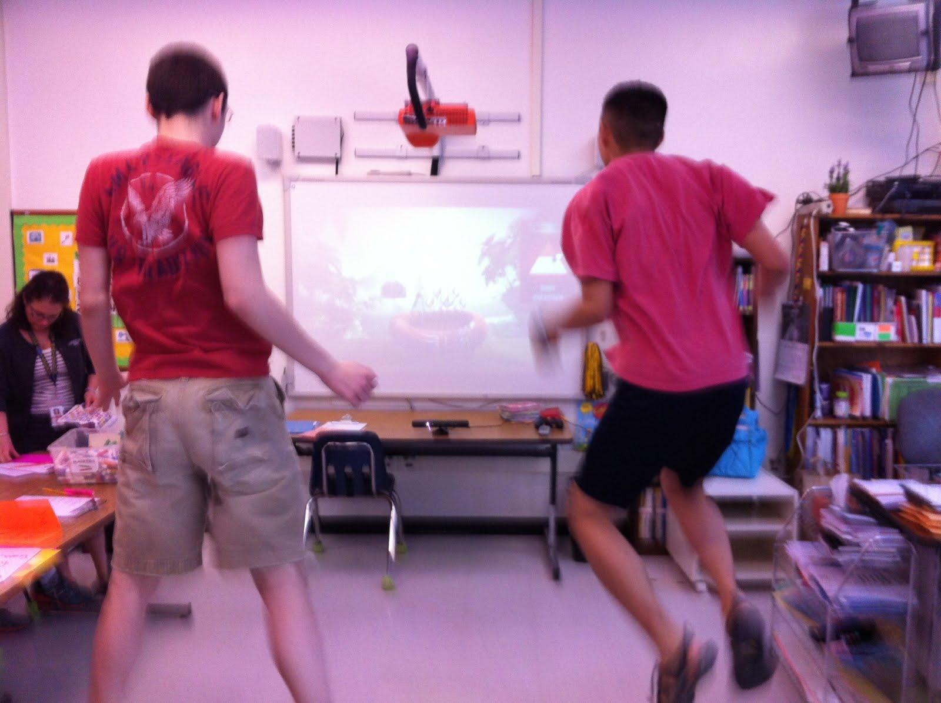
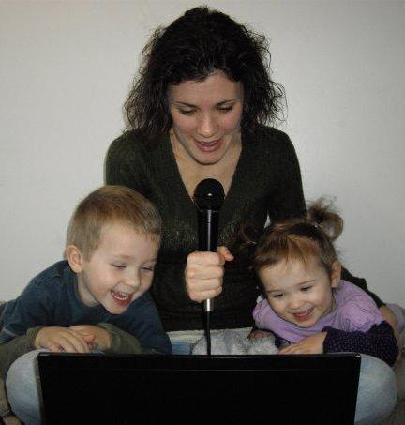
Upcoming VSTE Webinars!
Xbox 360 & Avatar Kinect
Dr. Tara Jeffs, Karen Dietrich, and Mark Nichols
March 20th, 2013 from 4:00pm to 5:00pm ET.
Can You Hear Me Now? Integrating Audio
in the Classroom with Melissa Bugaj
April 10th, 2013 from 4:00pm to 5:00pm ET.

Slide 31

June 12, 2013
ATIA Webinar:
If You Build It, They Will Read:
Authoring Books with Free Online Literacy Supports
http://bit.ly/buildbookwebinar
Judie Schoonover
Sally Norton-Darr

Slide 32

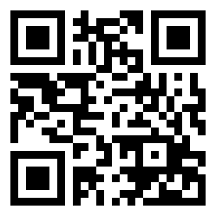
ATEval2Go:
An App to Help with
Evaluations & Consultations
http://bit.ly/ateval2go

Slide 33

This is………
Homework!:
http://bit.ly/cecjeopardy

Slide 34
Resources & References
The Practical (and Fun) Guide
to Assistive Technology in Public Schools:
http://iste.org/chewat
http://lcps.org/at
http://attipscast.com
http://bit.ly/alllearners
Notes:
UVM UDL
CAST
Natl udl\
A PDF of this entire presentation is available at
Iste/chewat

