Slide 1
iPad Deployment 2
An Evolving Process for K-12 School Districts
Dr. William Waller
VSTE Board of Directors
2012-2013 GRAETC Chair
Coordinator, Technology Services
Richmond City Public Schools
Email: wwaller@richmond.k12.va.us
Edmodo Group Code – yg5zq2

Slide 2
Deployment Pre-Planning Process
Establishment of the RPS Mobile Convergence Team
Determination of Pilot Participants
Creation of Pilot Data Assessment Process including timelines
Determination of and acquisition of equipment and assessories
Pilot implementation
Presentation to School Board

Slide 3
Deployment Strategy should be based on…
Good pre-planning
Appropriate funding-phased approach
Justification/usage of technology and applications
Content sources/curriculum alignment
Ongoing professional development

Slide 4
Deployment Strategy should be based on…
Ownership of applications
Level of IT involvement
Outsource vs. “in the house”
Good relationship with vendors

Slide 5
Deployment Strategy: From Ordering to Delivery
Target group is selected to receive devices
Applications are chosen based on curriculum/productivity needs for target group
Funding is appropriated
All hardware, applications, and services are purchased

Slide 6
Deployment Strategy: Services
Apple Services - Configuration Center
Some internal prep for Configuration Center
Mobile Device Management Server (MDM) – hosted off-site for device cataloging and tracking
Acquisition of 3 year insurance policy for each device purchased (Device model dependent)
Standardized Case Selection & Purchase

Slide 7
Deployment Strategy: From Delivery to Usage & Support
All devices purchased for Target group are received
Training dates are scheduled for Target group. Group receives devices during training
Support provided by Mobile Convergence Team/Apple
All updates provided on schedule by Mobile Convergence Team

Slide 8
Deployment Layout (to date)
Facility Services – 1:1
Exceptional Ed – 1:1 (partial)
Central Office Administration – 1:1
Instructional Specialists – 1:1
ITRT’s – 1:1
Principals/Assistant Principals
IT – 1:1 (partial)
4 Middle Schools (Math) – in progress
2 New Elementary Schools – K-2
Library Media Specialists (partial)- 1:1 – in progress

Slide 9
Apple iOS Deployment Models
Personal Ownership Deployment Model
Institutional Ownership Deployment Model
Layered Ownership Model

Slide 10
Personal Ownership Deployment Model
Assumes end-user is responsible for all applications
Applications are associated with end-user apple account
Devices are initially prepared with options for Supervision, latest iOS, and Configuration Profiles only

Slide 11
Institutional Ownership Deployment Model
Assumes District responsible for all applications
Applications are associated with district apple account
Devices are initially prepared with options for Supervision, latest iOS, Configuration Profiles, and Apps

Slide 12
Layered Ownership Deployment Model
Assumes District/End-User responsibility for all applications
Applications are associated with district & End-user apple account
Devices are initially prepared with options for Supervision, latest iOS, Configuration Profiles, and Apps

Slide 13
iPad Deployment – Pre-Planning “A Big Decision”
Site Deployment vs. Centralized Deployment

Slide 14
iPad Deployment – Pre-Planning
Set up email accounts that will be associated with Apple ID’s based on the appropriate deployment strategy and planning
Set up Apple IDs based on the appropriate deployment strategy and planning. Use one of the devices to create new Apple ID account using the “No-Credit Card Method”

Slide 15
iPad Deployment – Pre-Planning
Use iTunes to log into new account and acquire all free apps
Use Apple Volume Purchasing Program (VPP) if 20 or more licenses for any app will be purchased (app discounts). Use code acquired to download paid apps into iTunes.
Use Apple Configurator to import apps to be installed on devices. Also, import VPP app codes into Apple Configurator for all paid apps (will ask to verify Apple ID)

Slide 16
Apple Configurator Demonstration

Slide 17
Minimal Technical Requirements
Mac Desktop/Laptop with the following minimal Specifications:
OS X 7.5 (Lion)
8 GB RAM
1 TB Hard Drive
Apple Configurator Application

Slide 18
Minimal Technical Requirements
Mac Desktop/Laptop with the following minimal Specifications:
iTunes Application
Apple Configurator
iPhone Configuration Utility (optional)
Xcode Application (optional)

Slide 19
Minimal Technical Requirements
30 unit powered sync cart – may need lightning adapter if using 4th Gen iPads with older carts
Solid, secure wireless network (use SSID broadcasting)

Slide 20
iPad Deployment – A Model
Use Apple Configurator to prepare devices based on the deployment model chosen

Slide 21
Prepare Master Device Using Apple Configurator
Under settings, proceed to name the Master device
Set Supervision to on – “to Supervise or not to Supervise”
Under preferences, set lock screen image and/or text (optional)
Select latest iOS and check “erase before installing”

Slide 22
Prepare Master Device Using Apple Configurator
Leave the “restore” option at the default setting
Create/import all associated configuration profiles (usually district and MDM profiles)
Select all apps as specified
Select the “prepare” button at the bottom of the screen

Slide 23
Prepare Master Device Using Apple Configurator
Once Master Device has been created, reset all Apple Configurator settings to default
Use Apple Configurator to perform a backup of the Master Device

Slide 24
Prepare All Devices Using Apple Configurator
Under settings, proceed to set naming convention
Set Supervision to on – “to Supervise or not to Supervise”
Under preferences, set lock screen image and/or text (optional)
Select latest iOS and check “erase before installing”

Slide 25
Prepare All Devices Using Apple Configurator
Set the “restore” option to the Master Device Backup
Create/import all associated configuration profiles (usually district and MDM profiles)

Slide 26
Prepare All Devices Using Apple Configurator
Select “Apps” and check all apps to be installed on all devices. Make sure that VPP codes are also imported and set for all paid apps. This ensures licensing is appropriate (conflict here with using iTunes vs. Configurator for this step)
Select the “prepare” button at the bottom of the screen

Slide 27
Prepare All Devices Using Apple Configurator - Notes
There is an advantage for using Setup Assistant to personalize iPads in a 1:1 scenario. In this case, do not restore from a backup file
One benefit of Supervision is that all configuration profiles are installed automatically
Another benefit of Supervision is that iTunes will not recognize iPad when the user tries to sync it with another laptop.

Slide 28
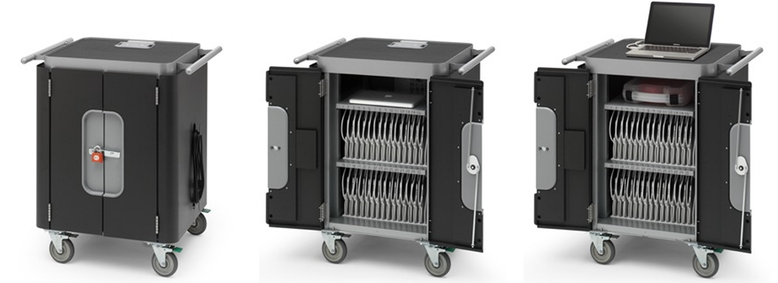
Bretford Power Sync Cart

Slide 29
Bretford Power Sync Tray

Slide 30
Questions

Slide 31
Resources
Apple IT Resources
Bretford Powersync Cart for iPad
Bretford Powersync Tray for iPad
Essential Rules for Using iPads in Classrooms

Slide 32
Resources
Apple Configurator
Apple iTunes
Xcode
iPhone Configuration Utility (Mac OS)
iPhone Configuration Utility (Win OS)

