Slide 1
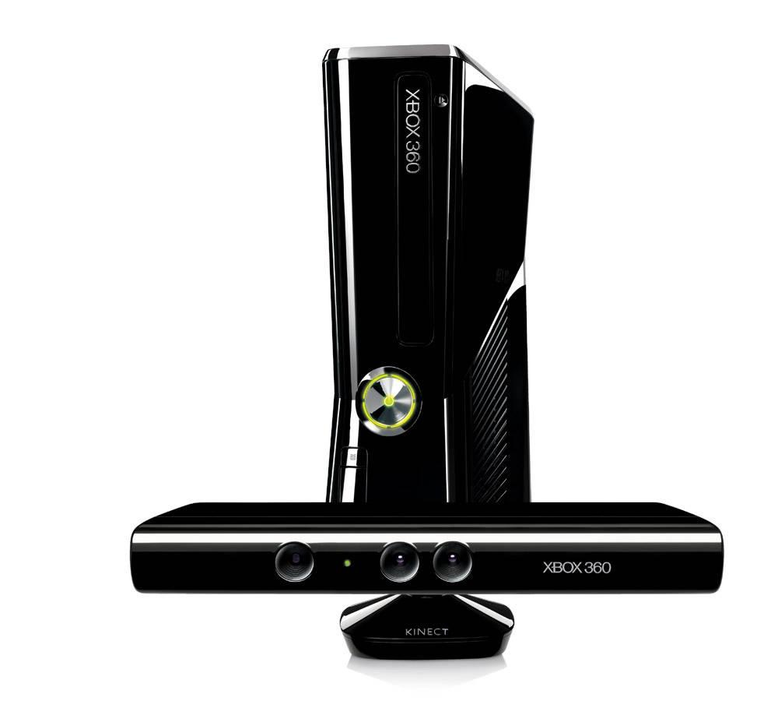
Get Your Body Moving!
Experiences with Gesture-Based Learning
using Xbox Kinect
Loudoun County Public Schools
Tara Jeffs, PhD.
Christopher Bugaj, MA CCC-SLP
Karen Dietrich, M.Ed
Mark Nichols, M.Ed

Slide 2

Link To This Presentation
http://bit.ly/xboxvsteweb13

Slide 3

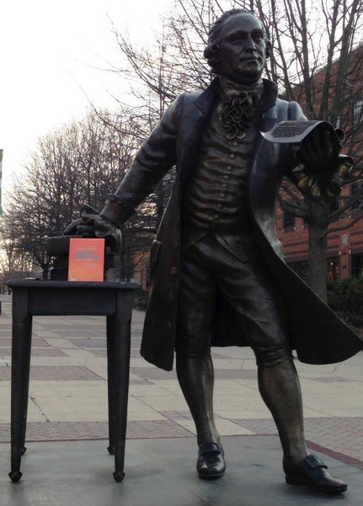
Coming Soon to a School Near You
Don't contact T/TAC yet, but your local T/TACs are working on a system to share Xbox 360s.
George Mason University will also be conducting research around the Xbox 360s.

Slide 4



Research on Benefits of Gesture-Based Learning
Brain Rules - Dr. John Medina
Kinesthetic Classroom - Mike Kuczala
Digital Bombardment - Ian Jukes
Game-Based Resources - Diigo

Slide 5
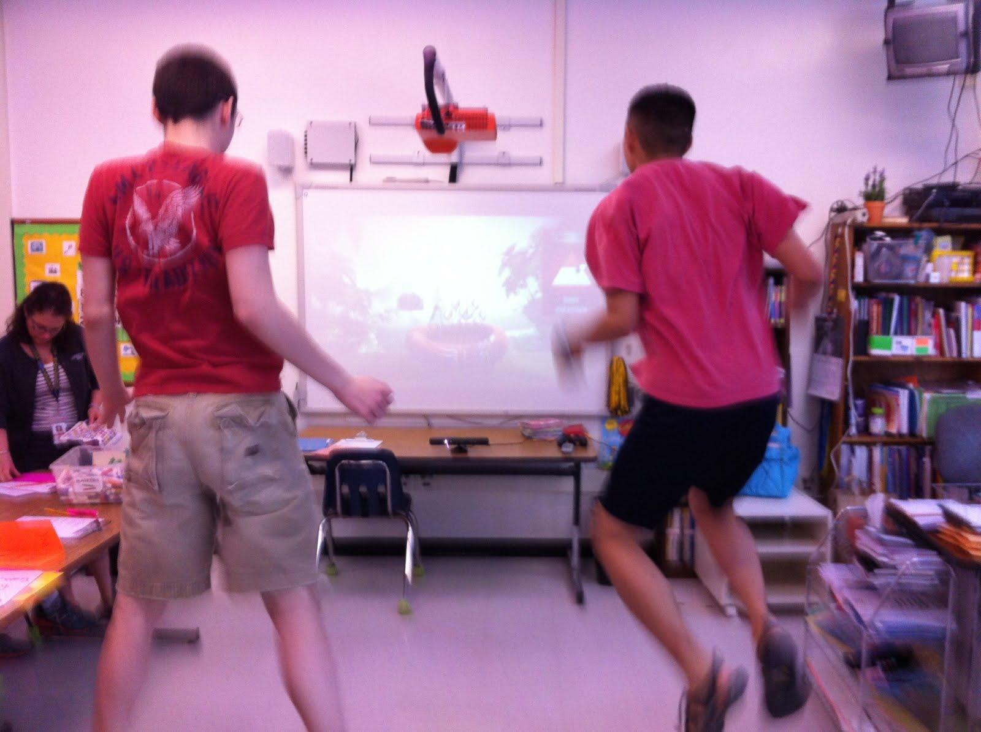
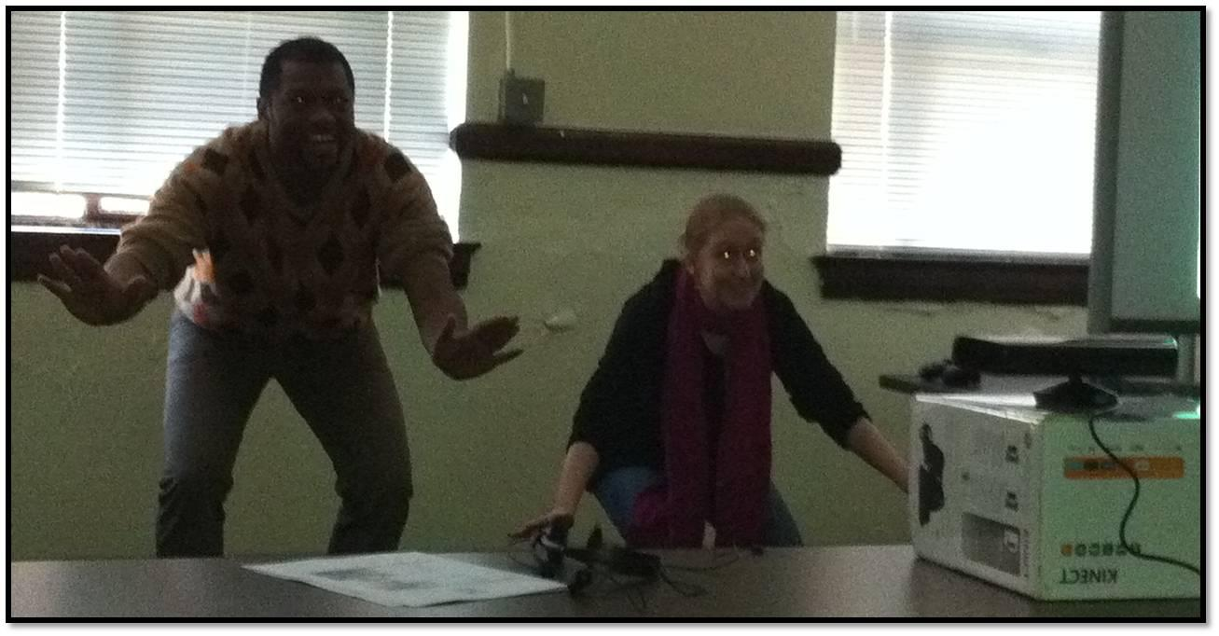
Benefits of Gesture-Based Learning
Shared Goal
Highly Engaging
Kinesthetic
SDK University and Developer Projects

Slide 6
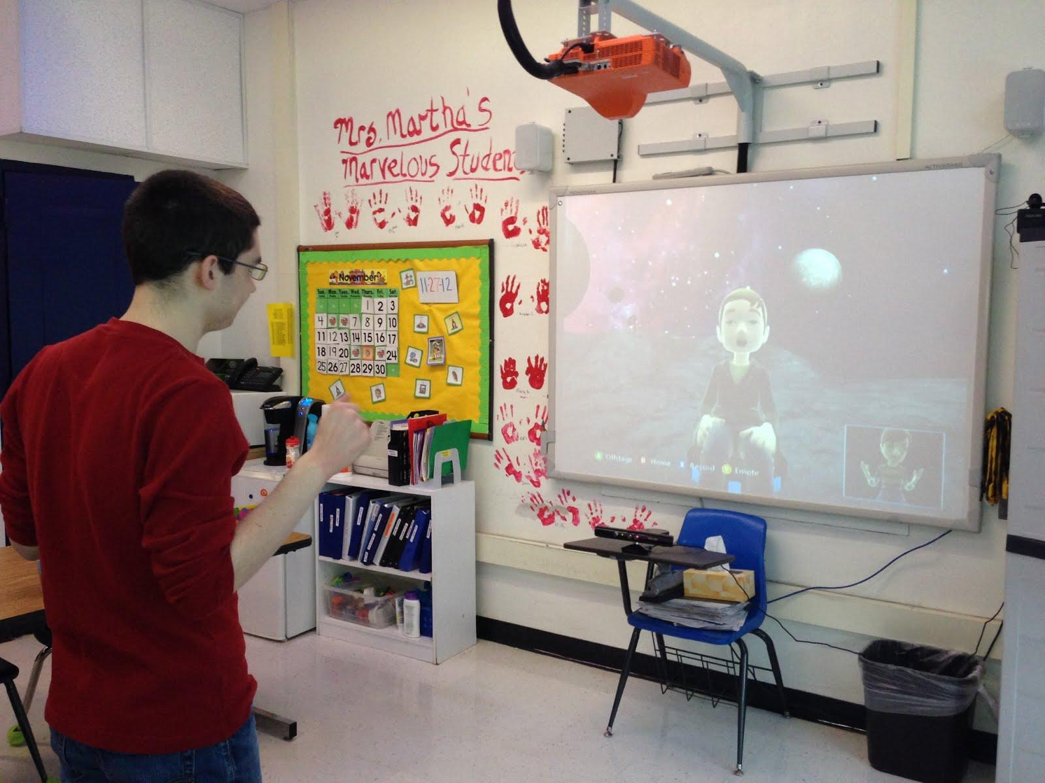
What is Xbox 360 Kinect?
What is Avatar Kinect?
Notes:
4gb unit, plugging a USB drive in to

Slide 7


Video Examples of Avatar Kinect
Ms. Triggs'
Video Testimonial
Allen's
Video Testimonial

Slide 8
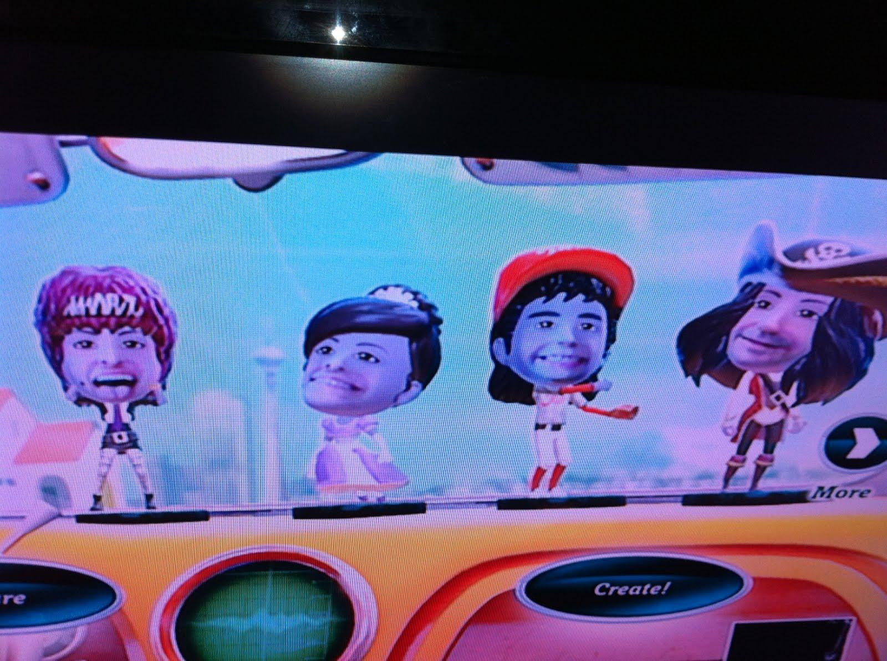

What is Video Kinect?
What Games are Available?
- Disk & Download
FUN LABS
Notes:
4gb unit, plugging a USB drive in to

Slide 9
Pilot Program Goals
Increase Collaboration
Increase Positive Behaviors
Increase Communication
Increase in Pragmatic Language Skills
Increase Academics
Progress on IEP Goals

Slide 10
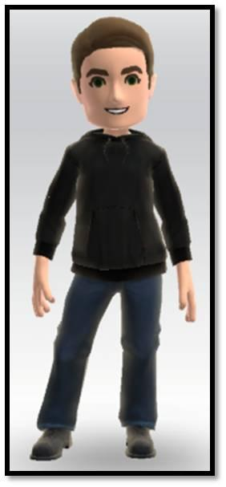
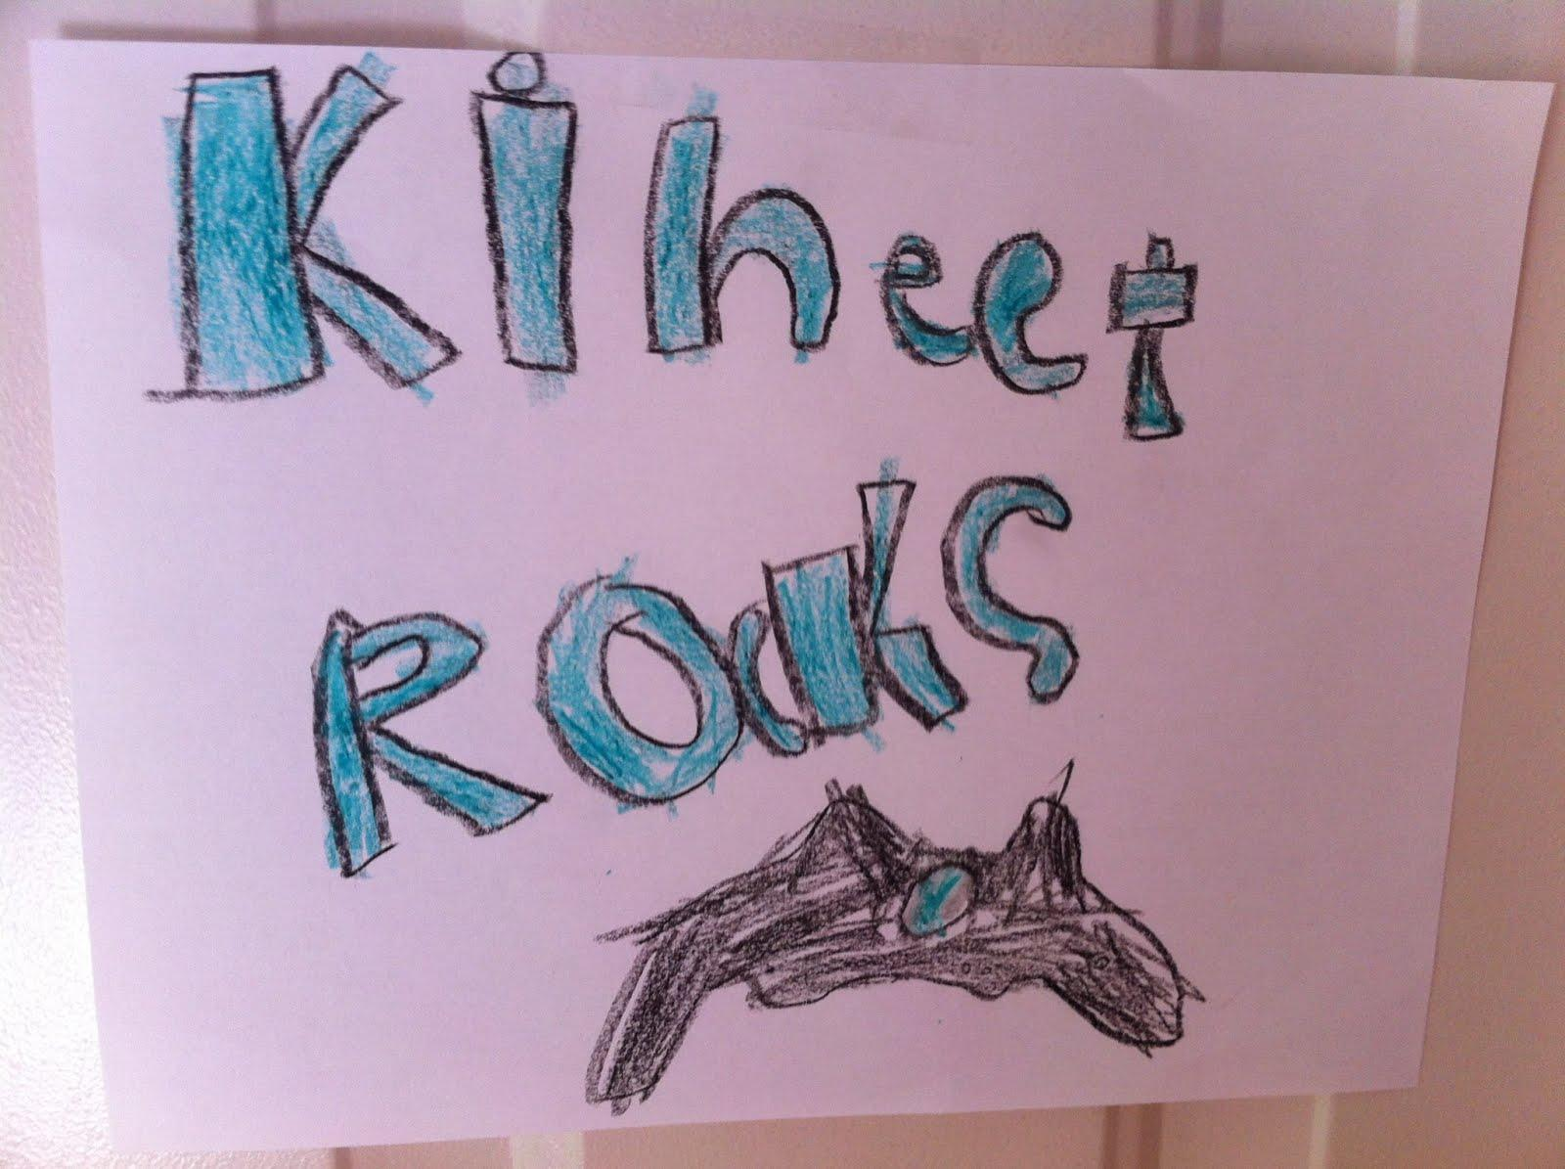
Pilot Program Parameters
4 Schools
4 Special Education Teachers
with Technology Resource TeacherSupport
Assistive Technology Trainers
Notes:
How teachers were selected, how things change, challenges of implementation

Slide 11
Pilot Program Parameters
Equipment Used
- Xbox 4GB HD
(Additional space available via external USB device)
- Kinect Sensor (Sensor Area Reducer Available)
- Games
- Xbox Live Subscriptions
- Headphones and/or Speakers
- Projectors and/or TV
- Cart
Moodle Course for Collaboration
Notes:
How teachers were selected, how things change, challenges of implementation

Slide 12
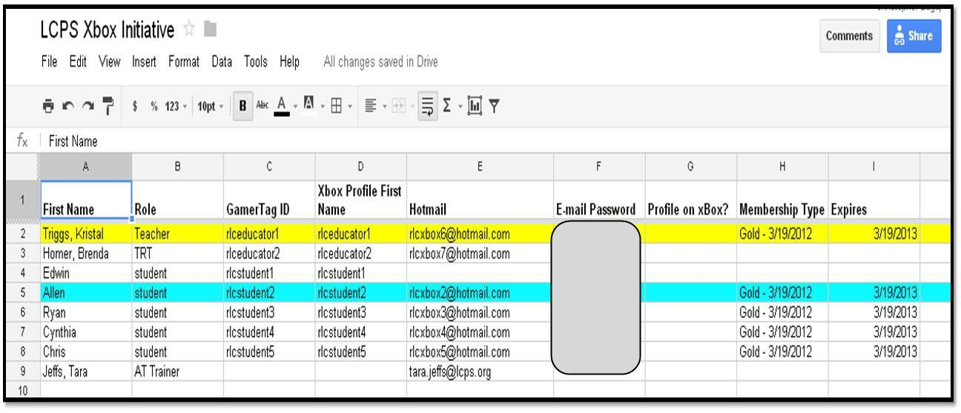
Behind the Scenes - Account Creation
1. Created Google Spreadsheet
2. Created E-mail Accounts

Slide 13

Behind the Scenes - Account Creation
3. Xbox Live Accounts / GamerTags
4. Xbox Live Gold Memberships

Slide 14
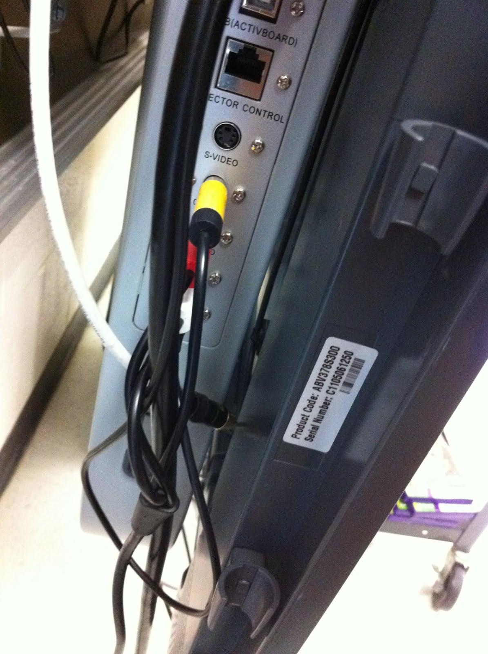
Unit Prep
Hardwire vs. Wifi
Projector vs. IWB vs. TV
Play Space
Kinect Sensor Placement
Audio/Video Cables
Lighting (On, Off, or Combination?)
Notes:
Dead batteries in the controller.

Slide 15
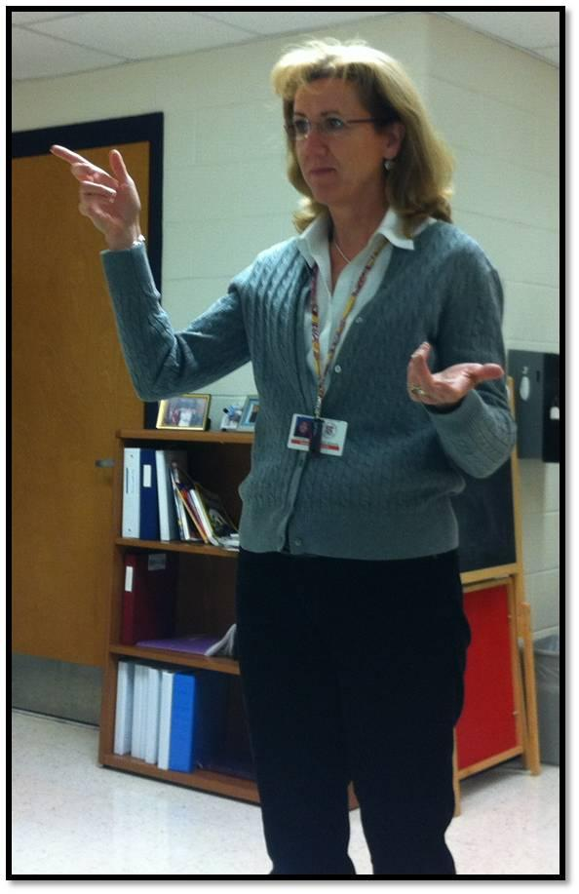
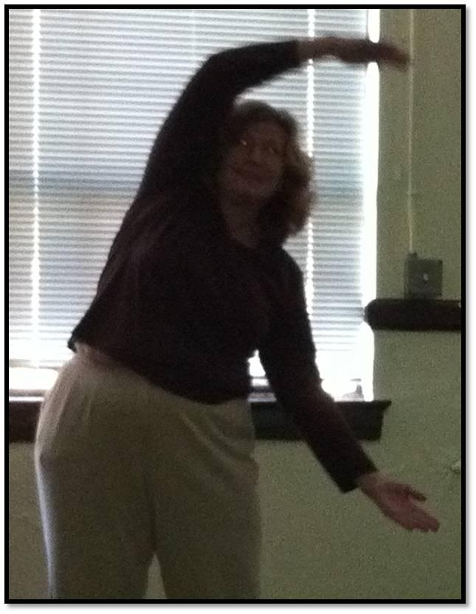
Learning To Be Users
AT Staff
needed to learn to navigate the
User Interface (UI).
Software updates happen and navigation changes.
Not a lot of tutorials on basic Xbox navigation.

Slide 16
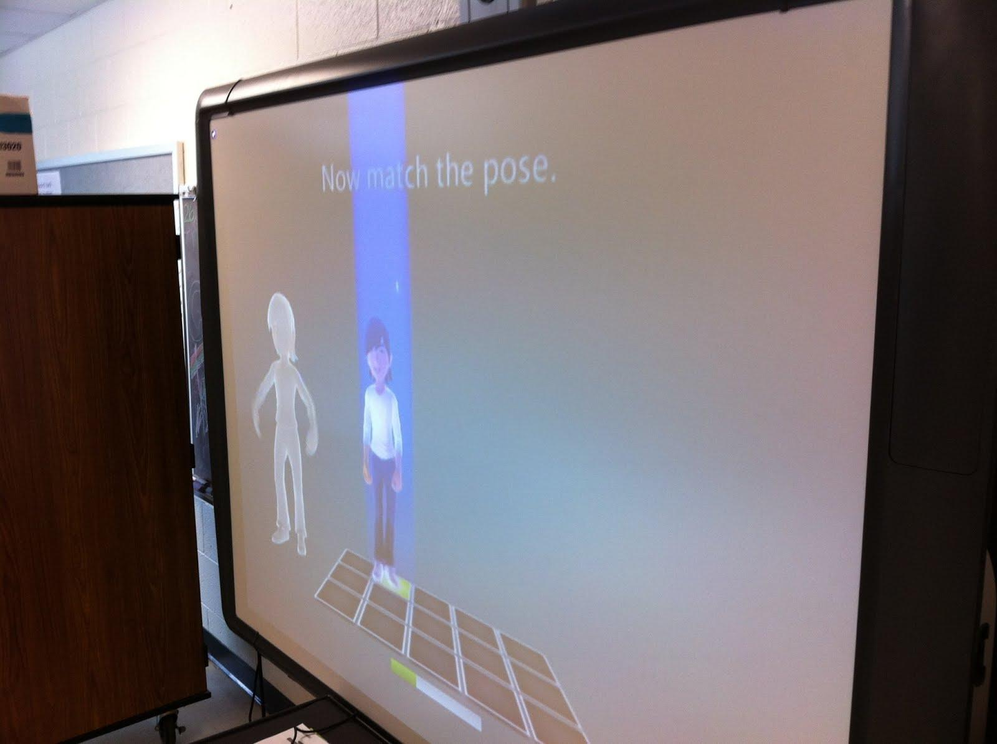
Practical Considerations
Kinect ID setup for facial recognition difficult for some students
? It seems to be
that you can only download a maximum of
8 profiles to an Xbox ?

Slide 17
Advice for Set-up
Define play space with objects (stay on mat, stay behind yard stick, etc.)
Turn the lights on for the Kinect sensor to initially recognize the players but then turn them off to see the screen better.
Article with Start-up Tips:
http://bit.ly/xbox4edlcpsadvice

Slide 18
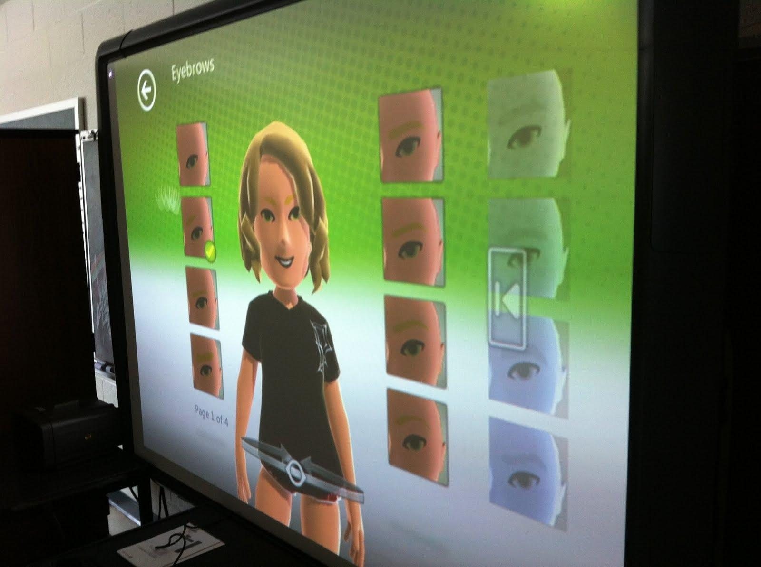
Advice for Set-up
Conduct a group activity to setup a teacher's avatar.
Individual activity to setup personal avatar to learn gestures - Scaffold this activity per user.

Slide 19
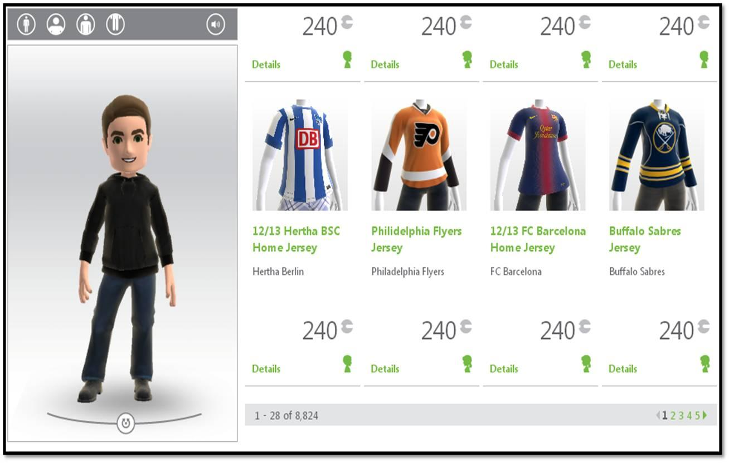
Avatar Creation - Fitting Room

Slide 20
Qualitative Results
Students with Autism communicating with one another.
- Giving and following directions
- Asking questions
- Showing interest in others

Slide 21
What's Next for the Pilot?
1. More Student to Student Interactions
- In-Person (between students in the room)
- Virtually (using Avatar Kinect)
- Group Discussions
2. Opportunities for students to engage in gaming for academics to reinforce concepts outlined in their IEPs.
3. Kinect Share (Video Collection)
- Monologues
- Data Collection, Collection of Evidence

Slide 22
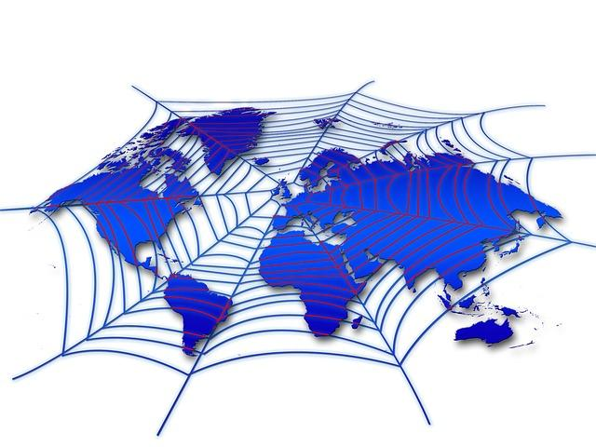
What's Next for the Pilot?
4. Collaborate with others outside our district.
Henrico County - http://blogs.henrico.k12.va.us/pocahontaskinect
- Other states
- Internationally

Slide 23
What's Next for the Pilot?
Let's See What The
Teachers
and Students
Come Up With

Slide 24
Additional Resources
Tutorials
How-to's Created by LCPS
for UI Navigation
Xbox on LCPS AT Diigo
Article, Websites, Videos, etc.
Kinect for Education Facebook Page

