Slide 1
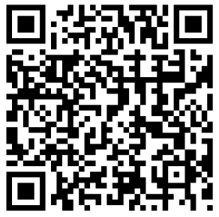
QR Codes
Mike Speidel, Staff Development Trainer
Derek Kaufman, Technology Resource Teacher
What’s Black and White and Promotes Collaboration?

Slide 2
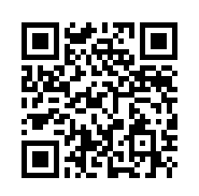
WHAT IS A QR CODE?
Quick Response Code.
2D barcode
Can store much more information than traditional barcodes
Free to use
Notes:
Originally developed by a Denso Wave in 1994 to track truck parts.
Peggy:

Slide 3
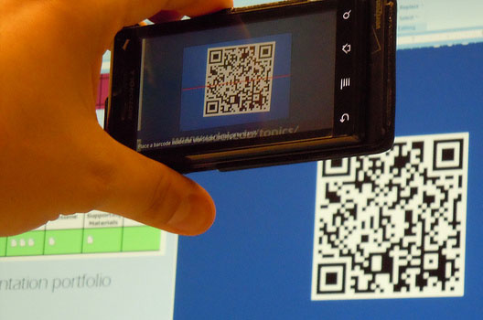
DEVICES TO READ QR CODES
Smartphone with Camera
iPad or tablet with camera
Also can use a webcam
Notes:
Any device that has a camera and an Internet connection
Peggy: using ipad2 and apple’s itouch devices in the classroom

Slide 4
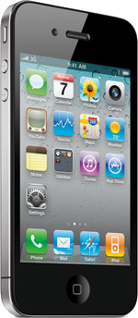
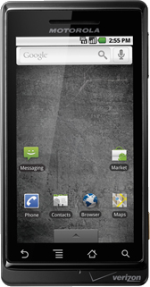
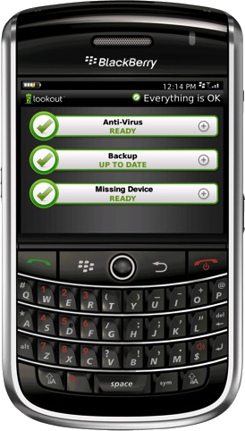
Apps for reading QR Codes
Blackberry
QR Code Scanner
BeeTagg
iPhone/iPad
QRAFTER (recommended)
i-Nigma (recommended)
Red Laser
Bee Tagg Reader Pro
Droid
QR Droid (recommended)
BeeTagg

Slide 5
Advertising

Slide 6
Coupon

Slide 7
Nutritional Information

Slide 8
Airport Check-In

Slide 9
Business Card

Slide 10
Product Information

Slide 11
Things to do with QR Codes
Calendar Event
Contact Info
URL
E-mail address
Geo location
Text box
SMS
Wifi
Phone number

Slide 12
That’s great, but….
How does this apply to education?

Slide 13
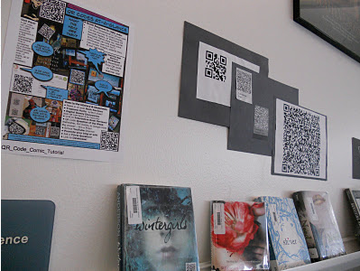
QR Codes with Literature
record book reviews and attach the QR code to the inside cover of the book
stick QR codes in reading books that the children take home
students create QR codes that offer supplemental information for the reader
Notes:
Our children are beginning to write book reviews for books that are currently in the library. Students will scan the QR code and will hear book reviews. Authentic purpose for writing.
2. These could link to online comprehension questions for parents or to websites that children can use to find out more information about the books or to related games that they can play.
3. (especially useful in historical fiction or stories where the setting plays an important role).
http://www.youtube.com/watch?v=OE5Ch4NnVu0

Slide 14
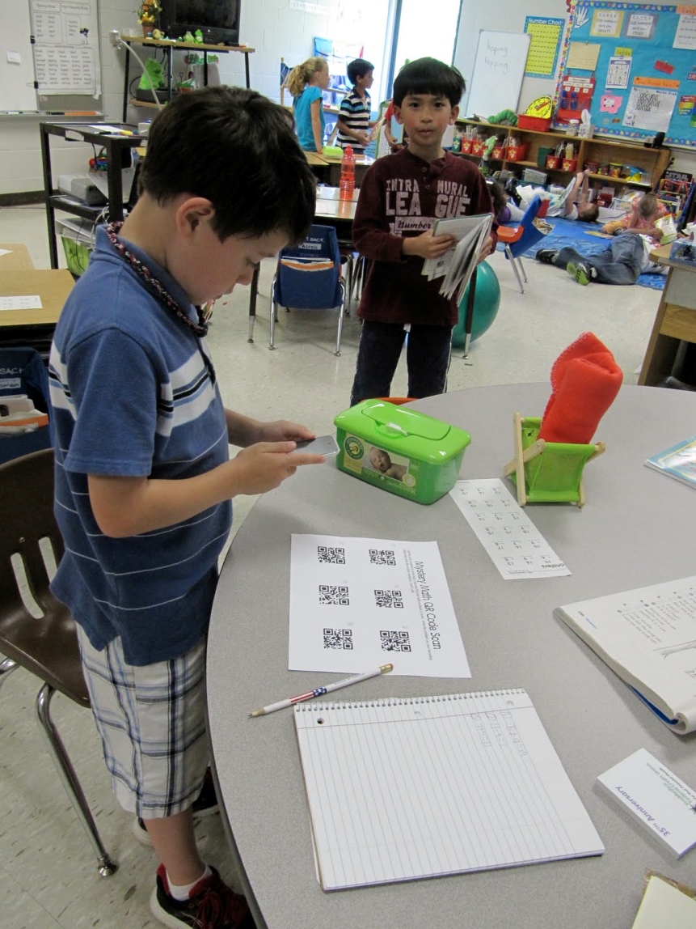
Independent Research Centers
This encompasses all of our student based projects.
Notes:
Planets
Mineral Resources
Animal Adaptations

Slide 15
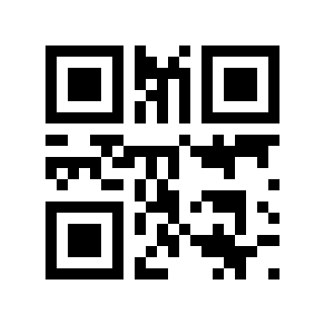
Foreign Language

Slide 16
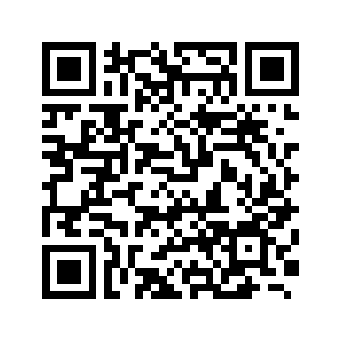
Foreign Language
La tienda =
La oficina =
El supermercado =

Slide 17
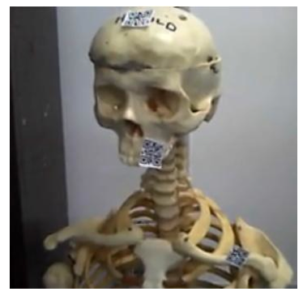
Science
Students scan QR codes for video tutorials of equipment use or modeling of a procedure
Explore physical models …attach QR Codes to a physical object to allow for a thorough exploration of the object.

Slide 18
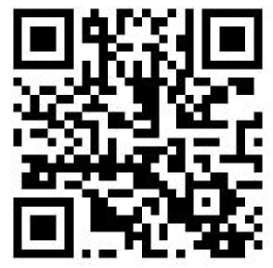
Science
Notes:
**Video links for PE classes – how to do a push-up, sit-up, etc. properly.

Slide 19
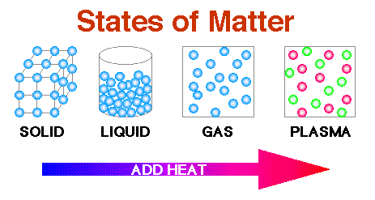
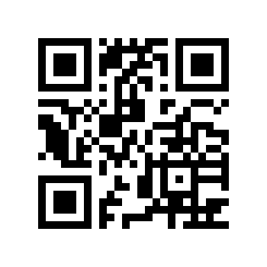
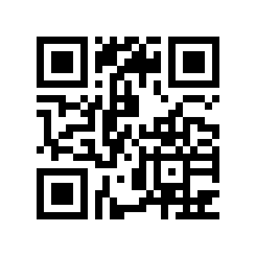
Science
Link to Student Document

Slide 20
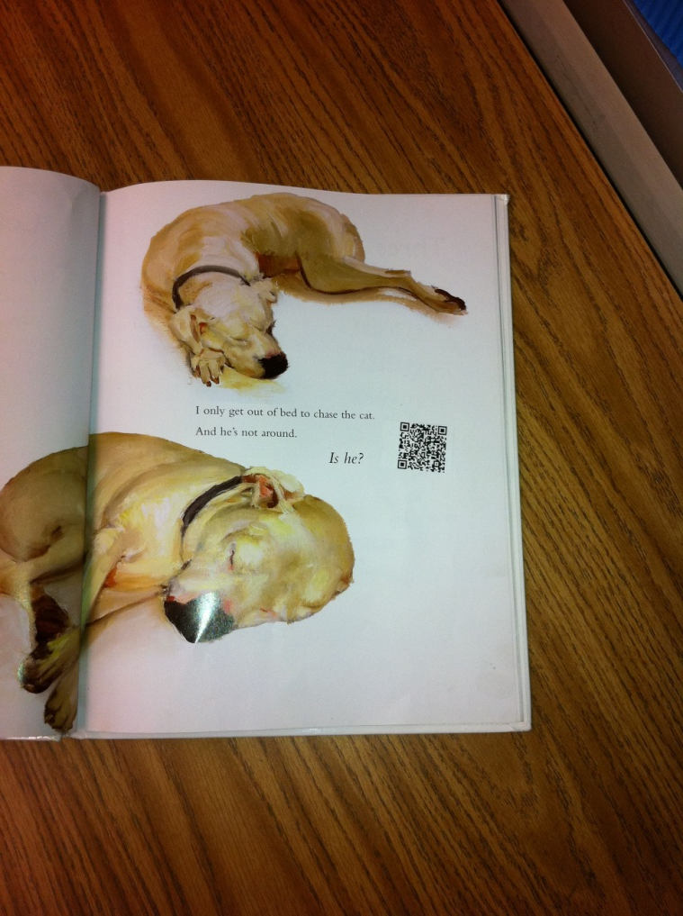
Digital Content
Notes:
Talk about links to videos from the book to extend the activity / enrichment.

Slide 21
Social Science

Slide 22
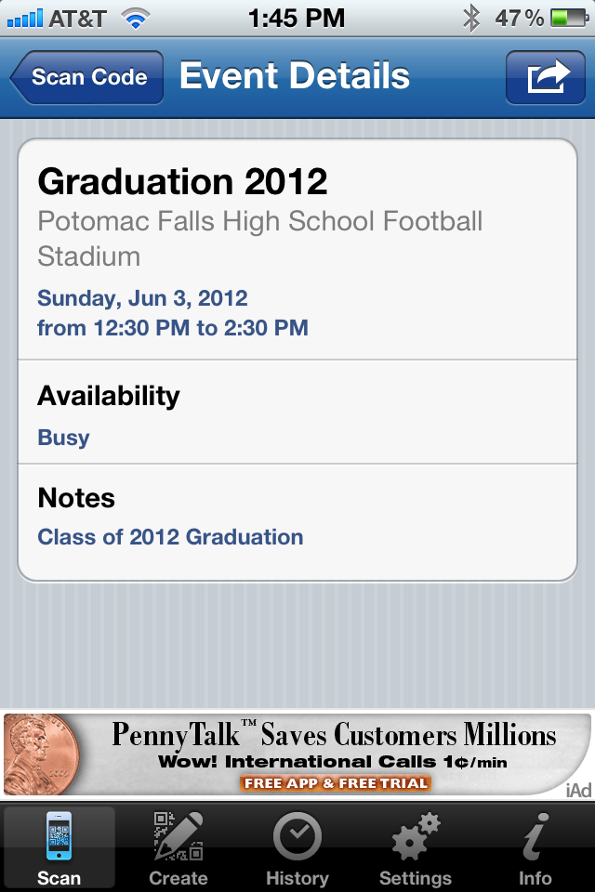
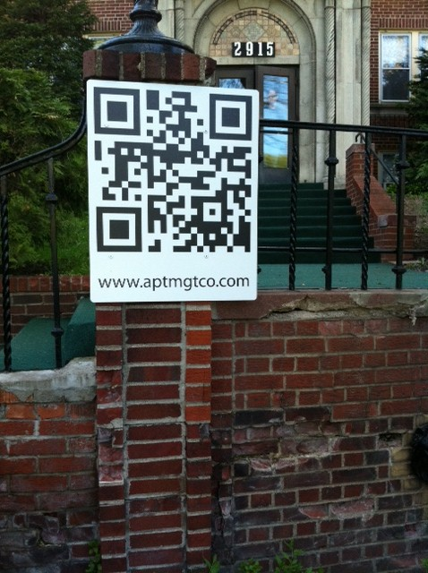
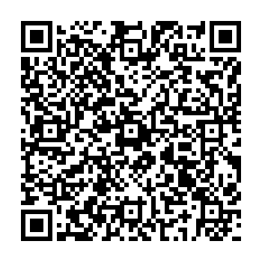
School Events
Notes:
*Create a Google Calendar and use link to create a QR code to the calendar.

Slide 23
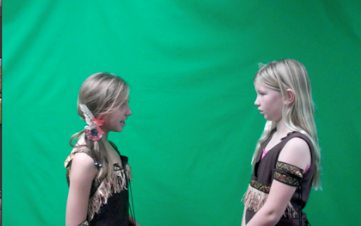
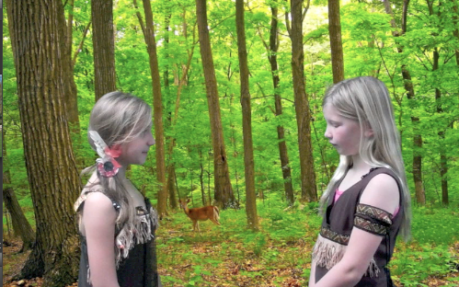
Published Student Work
Display student work in embedded QR codes.
Parents travel to each display and scan the QR code to watch their child’s project.
Notes:
VA fair photo here

Slide 24
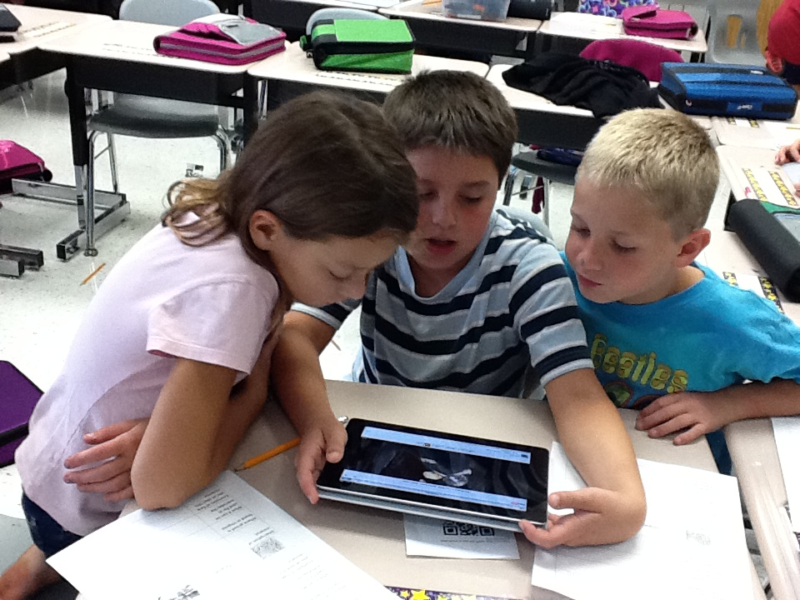
ASSESSMENT
Hide the answers to a study guide behind a QR code. Copy the code onto the study guide so students can check their answers.
Notes:
Study guides Formative and/or summative assessment piece for student self-evaluation

Slide 25
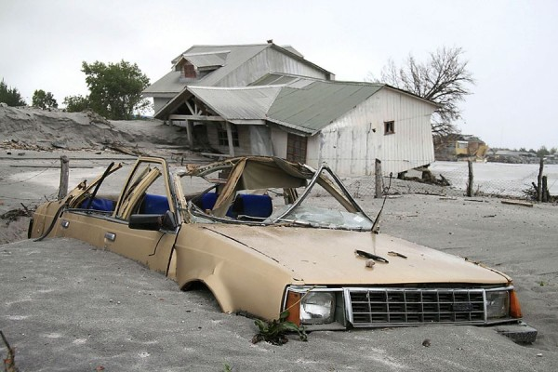
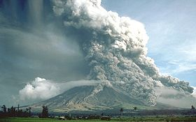
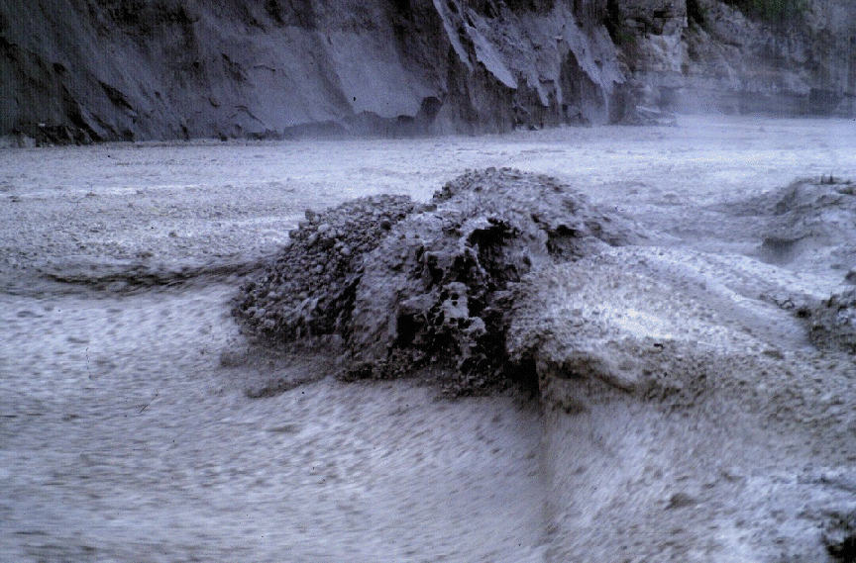
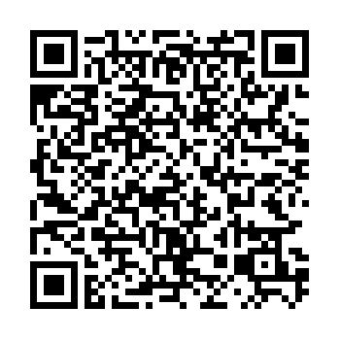
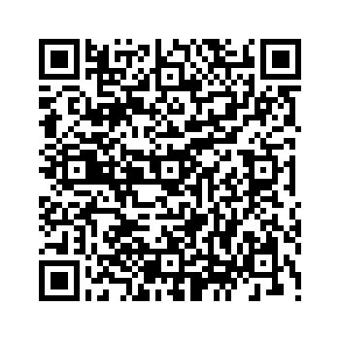
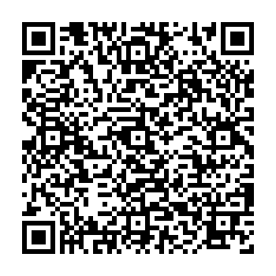
Check Answers
Identify and justify the type of hazard: | Identify and justify the type of hazard: | Identify and justify the type of hazard:
From, Mark Rollins@muppetmasteruk

Slide 26
Calendars
Notes:
Problem of the day

Slide 27
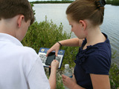
Interactive Field Trips
Notes:
This National Wildlife refuge has developed an iNature trail that goes a step further and incorporates short, engaging YouTube videos, making it more interactive. For instance, one of the 22 QR codes along the iNature Trail

Slide 28
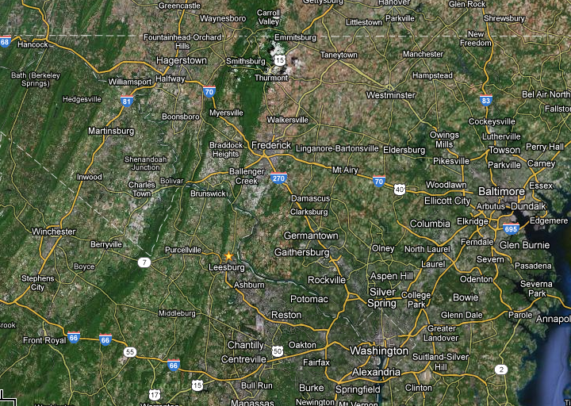
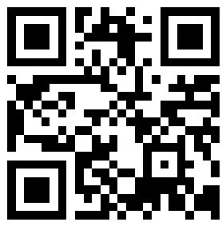
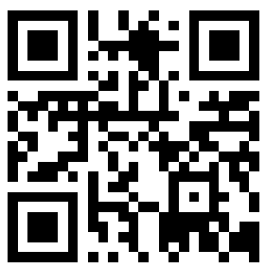
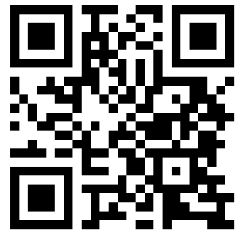
Scavenger Hunt
Antietam
Gettysburg
Manassas

Slide 29
Shorten & Track QR Codes goo.gl
Tracks the number of times the QR code has been “hit”
Steps
1.) Copy/Paste URL into goo.gl
2.) Copy/paste shortened URL into QR Code generator (ex: http://goo.gl/SmyUs)
3.) Access “hits” via the shortened URL with a “+” on the end (ex: http://goo.gl/SmyUs+)

Slide 30
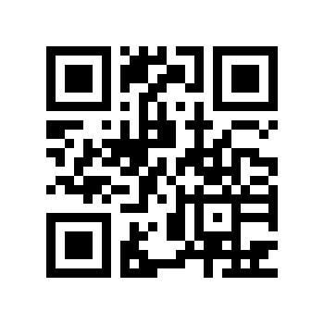
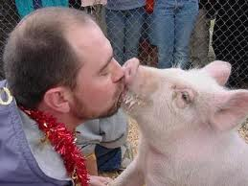
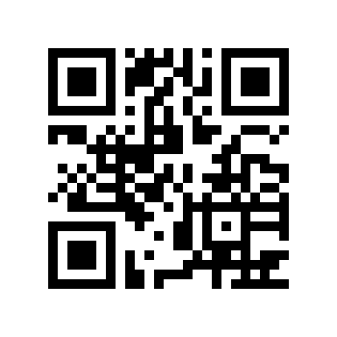
Voting Contests
Kiss The Pig Fundraiser
Vote: Mr. Hastkins
Vote: Mrs. Miller

Slide 31
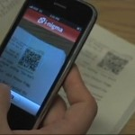
Benefits of QR Codes in the Classroom
Promotes active engagement
Teacher is the facilitator
Student-directed instruction
Instant feedback for students and teachers
Brings the outside world instantaneously
Narrow the gap of time spent on instruction when finding resources
Promotes collaboration between student peers
Facilitates communication between home and school

Slide 34
QR Creation Sites
ZXing Project : http://zxing.appspot.com/generator/
BeQRious: http://beqrious.com/
Delivr: http://delivr.com/qr-code-generator
Azonmedia: http://azonmedia.com/qrcode-generator
Maestro: http://www.sparqcode.com/static/maestro
goQR.me: http://goqr.me/
Online Qr Lab: http://onlineqrlab.com/
Mobile-Barcodes: http://www.mobile-barcodes.com/qr-code-generator/
KAYWA: http://qrcode.kaywa.com/
BoxMeUp: http://boxmeupapp.com/

Slide 35
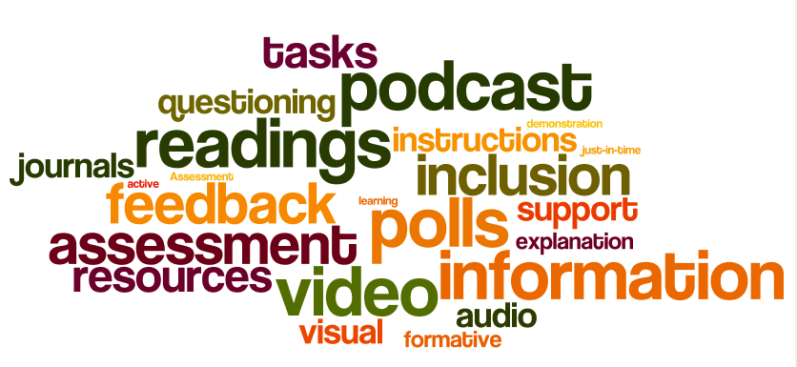
Why Use QR Codes?

Slide 36
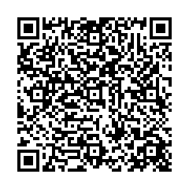
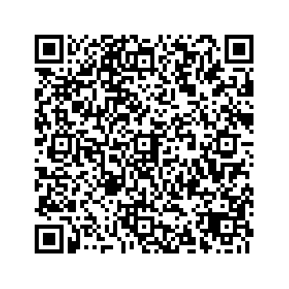
Questions or Comments
Mike Speidel – Staff Development Trainer
Loudoun County Public Schools, VA
Derek Kaufman– Technology Resource Teacher
Loudoun County Public Schools, VA

